Slide 1
CS3332: Implementation and Testing

Slide 2
Phase 4 Implementation and Testing
Develop a running prototype. You need to implement the software using object-oriented language such as C++, C#, or Java. The prototype should have two functionalities designated by the instructor. GUI is NOT required.
You must implement all features!!
Design test cases that have test data and expected results. Testing must be conducted in all use cases to show how well your use cases work. Test should be conducted with correct inputs and incorrect inputs. You are required to turn in your test results with test cases.
Each team will set up a meeting with the instructor to demonstrate features of the prototype.

Slide 3
Phase 4 Implementation and Testing
Testing
White Box Test
Testing performed by developers
Have full knowledge of the program and code
Black Box Test
Testing without knowledge of internal structure or the program or the code
It is tested by software testers
White Box Testing is what you must perform
Your team is the developer of your team’s software
Test your secure use case with white box testing
Test case name
Description
Input
Expected Output
Actual Output

Slide 4
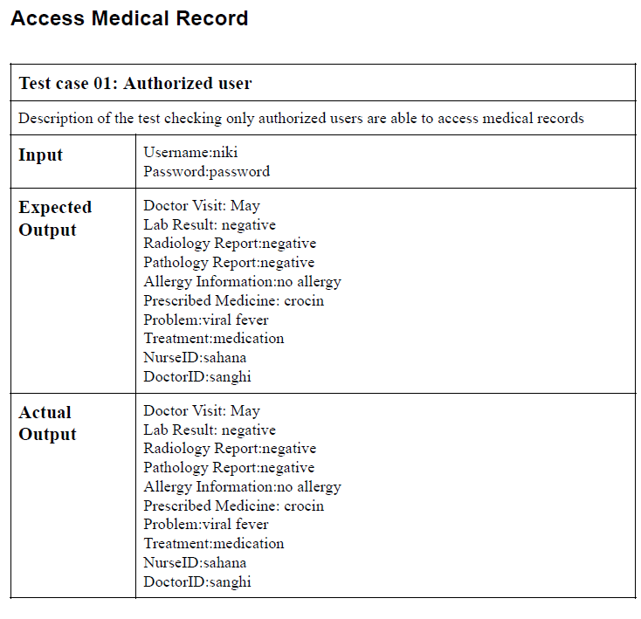
Phase 4 Implementation and Testing
Example

Slide 5
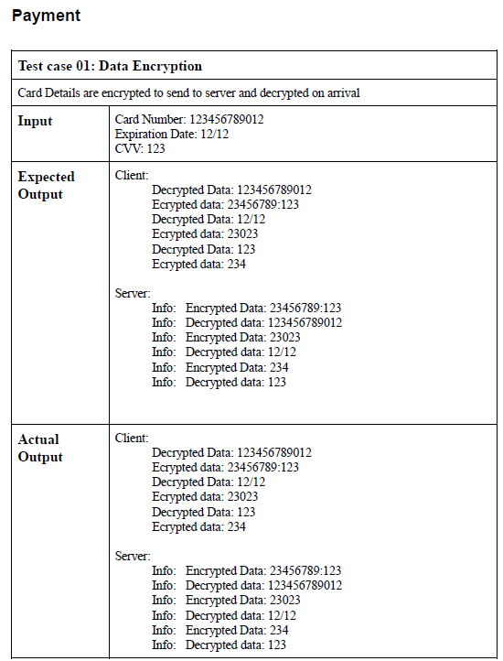
Phase 4 Implementation and Testing
Example

Slide 6
Phase 4 Implementation and Testing
Must provide test cases for each use case
Minimum: 1 case that returns correct, 1 case leading fault case
You are required to turn in your test results
Provide screenshot of your outputs

